Slide 1
Velocity Control for Mobile Robots
Dr. Troi Williams
Slide Credits: Dr. Levi Burner (PRG)

Slide 2
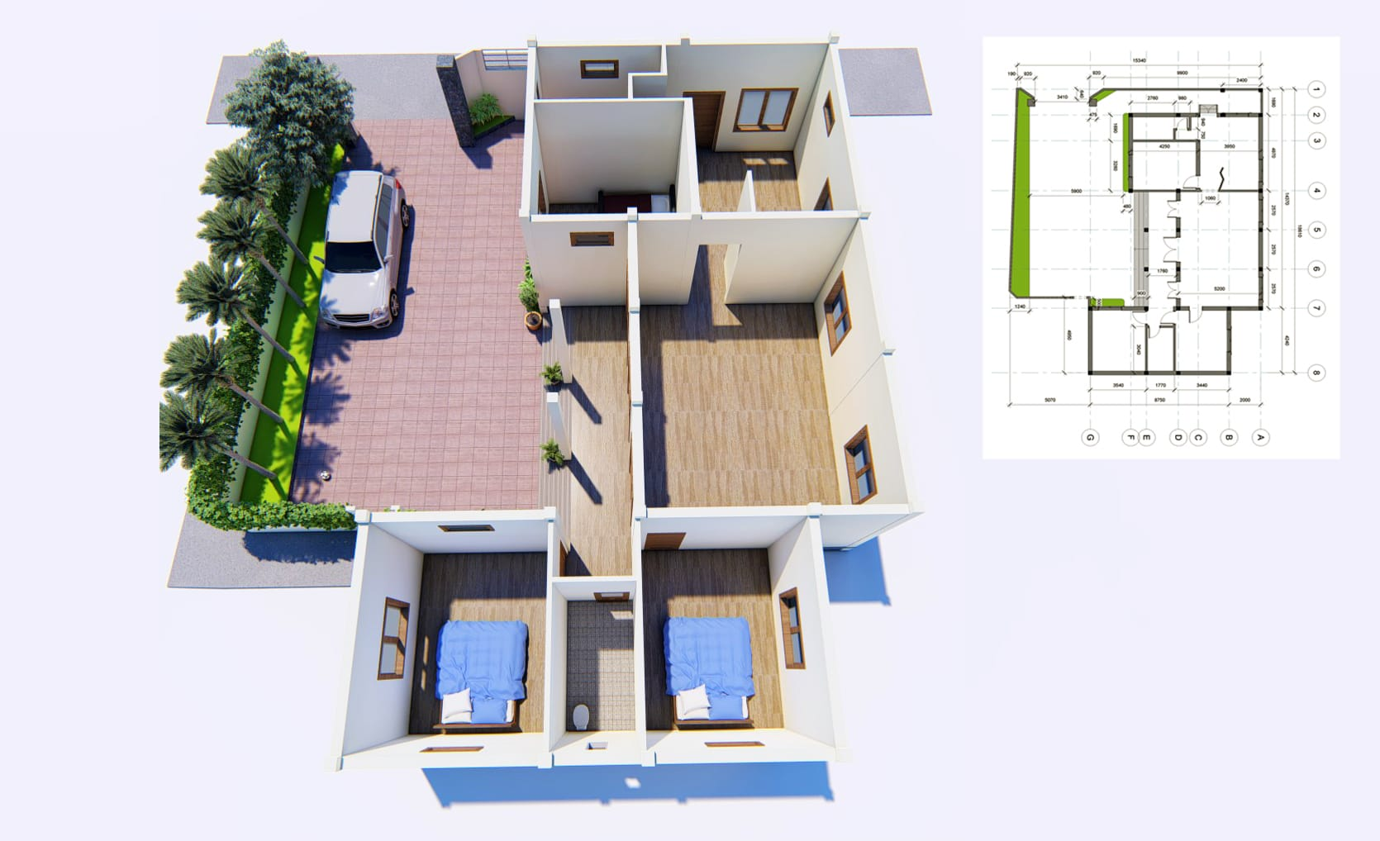
Given a path (red)
How do we track it? (blue)

Slide 3
Agenda
Velocity control in the world frame
Derivation (not intuitive, equations)
Making sense of it (intuitive, block diagrams)
3D Transforms and Notation
Transforming camera measurements to world frame
Heading control

Slide 4
Introduction
There are many ways to track a path
The simplest way is in the world frame
Robot estimates its position in the world
Move to get closer to some desired position
Another way is in the ego-frame (camera frame)
Move so that an object (AprilTag) is at a desired pixel location
This is the bonus problem for Project 1
We are going to focus on the former
Pros:
Much easier to understand
Cons:
Can be “noisier”

Slide 5
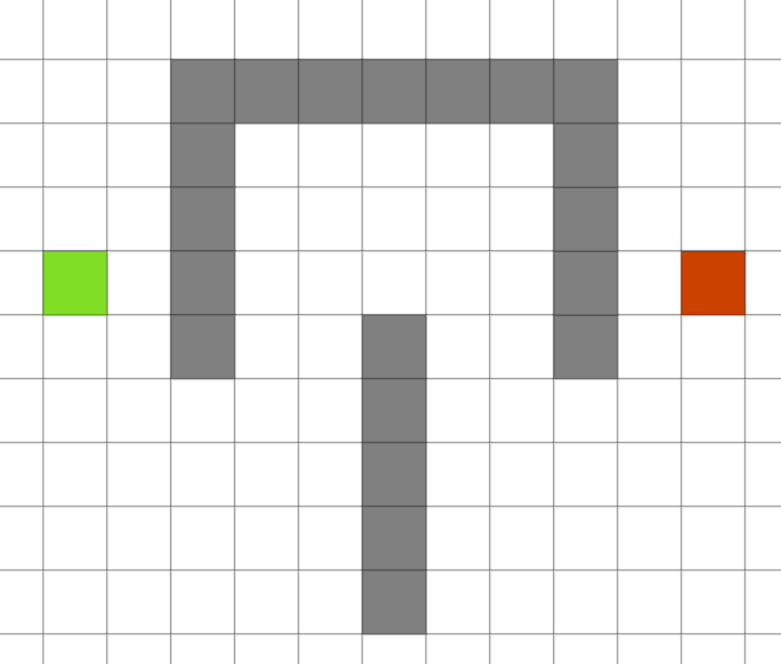
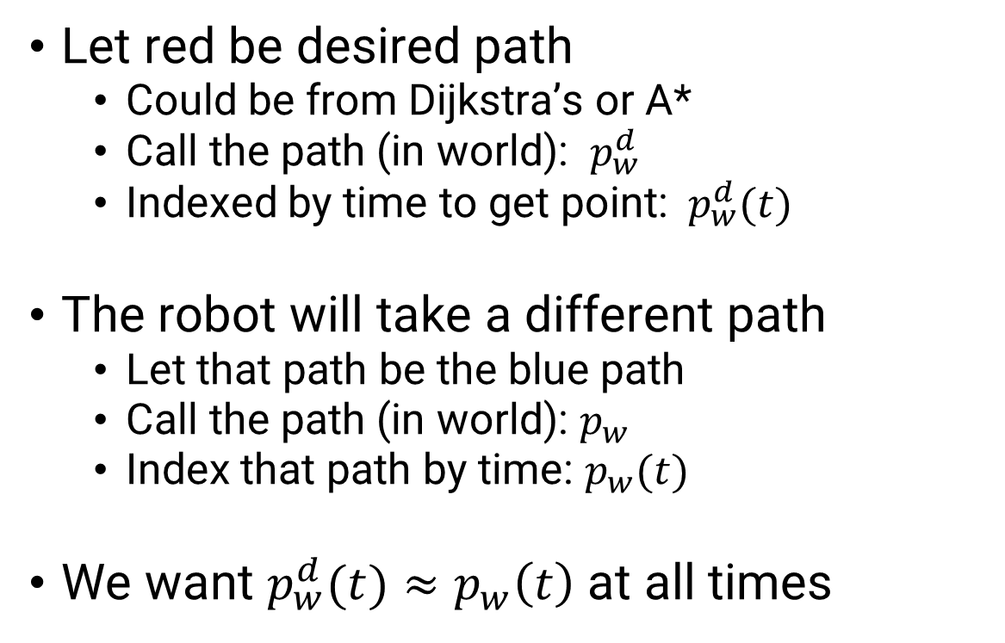
Trajectory Tracking Task
Let red be desired path
Could be from Dijkstra’s or A*
Call the path (in world): $p_{w}^{d}$
Indexed by time to get point: ${ p}_{w}^{d}(t)$
The robot will take a different path
Let that path be the blue path
Call the path (in world): $p_{w}$
Index that path by time: $p_{w}(t)$
We want $p_{w}^{d}(t)≈p_{w}\left(t\right)$ at all times

Slide 6
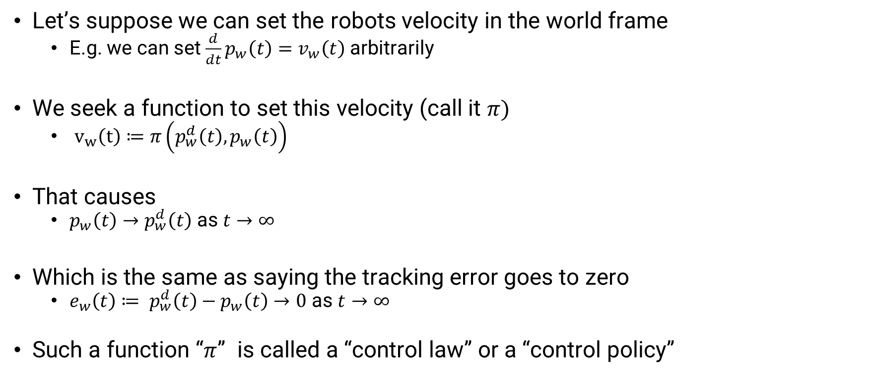
Trajectory Tracking Math
Let’s suppose we can set the robots velocity in the world frame
E.g. we can set ${\frac{d}{dt}p}_{w}\left(t\right)=v_{w}\left(t\right)$ arbitrarily
We seek a function to set this velocity (call it $π)$
$v_{w}\left(t\right)≔π\left(p_{w}^{d}\left(t\right), p_{w}\left(t\right)\right)$
That causes
$p_{w}\left(t\right)→p_{w}^{d}\left(t\right)$ as $t→∞$
Which is the same as saying the tracking error goes to zero
$e_{w}\left(t\right)≔ p_{w}^{d}\left(t\right)−p_{w}\left(t\right)→0$ as $t→∞$
Such a function “$π$” is called a “control law” or a “control policy”

Slide 7


Trajectory Tracking Math
How do we make the error “$e_{w}(t)$” go to zero?
Let’s assume “$e_{w}$” is just for X or Y axis alone
0
$$e$$

Slide 8
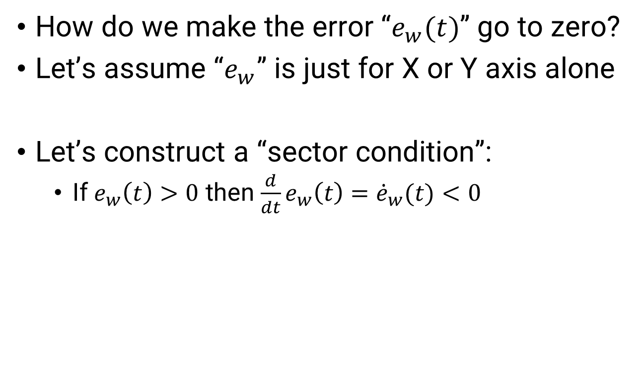
Trajectory Tracking Math
How do we make the error “$e_{w}(t)$” go to zero?
Let’s assume “$e_{w}$” is just for X or Y axis alone
Let’s construct a “sector condition”:
If $e_{w}\left(t\right)>0$ then $\frac{d}{dt}e_{w}\left(t\right)={\dot{e}}_{w}(t)<0$
0
$$e$$

Slide 9
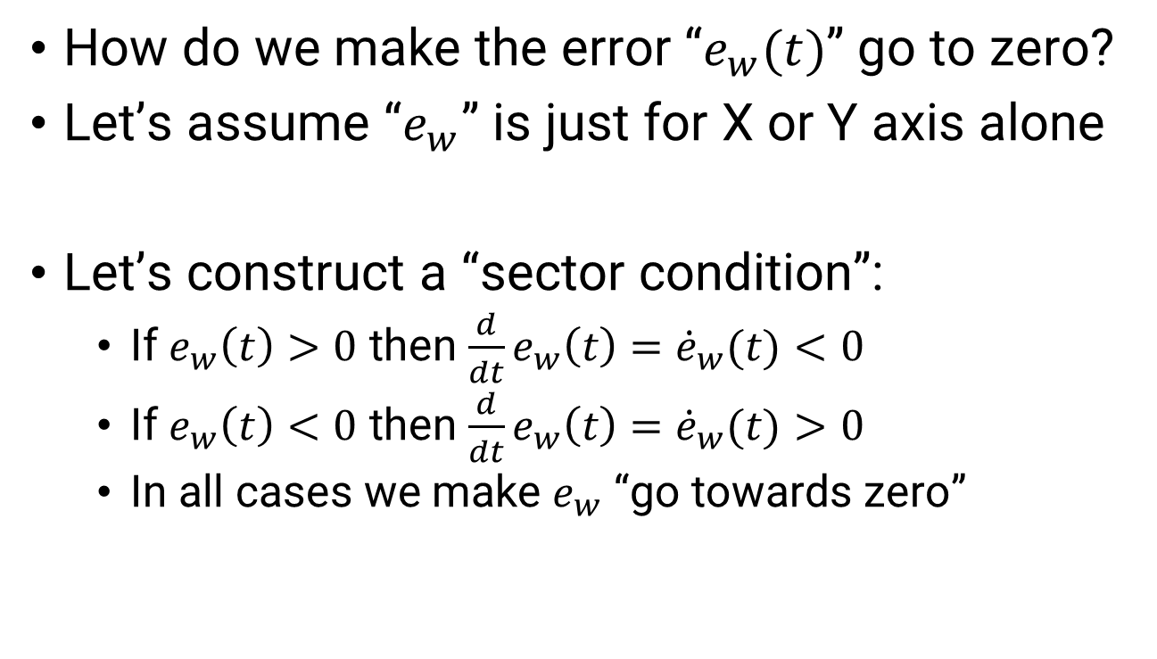
Trajectory Tracking Math
How do we make the error “$e_{w}(t)$” go to zero?
Let’s assume “$e_{w}$” is just for X or Y axis alone
Let’s construct a “sector condition”:
If $e_{w}\left(t\right)>0$ then $\frac{d}{dt}e_{w}\left(t\right)={\dot{e}}_{w}(t)<0$
If $e_{w}\left(t\right)<0$ then $\frac{d}{dt}e_{w}\left(t\right)={\dot{e}}_{w}(t)>0$
In all cases we make $e_{w}$ “go towards zero”
0
$$e$$

Slide 10
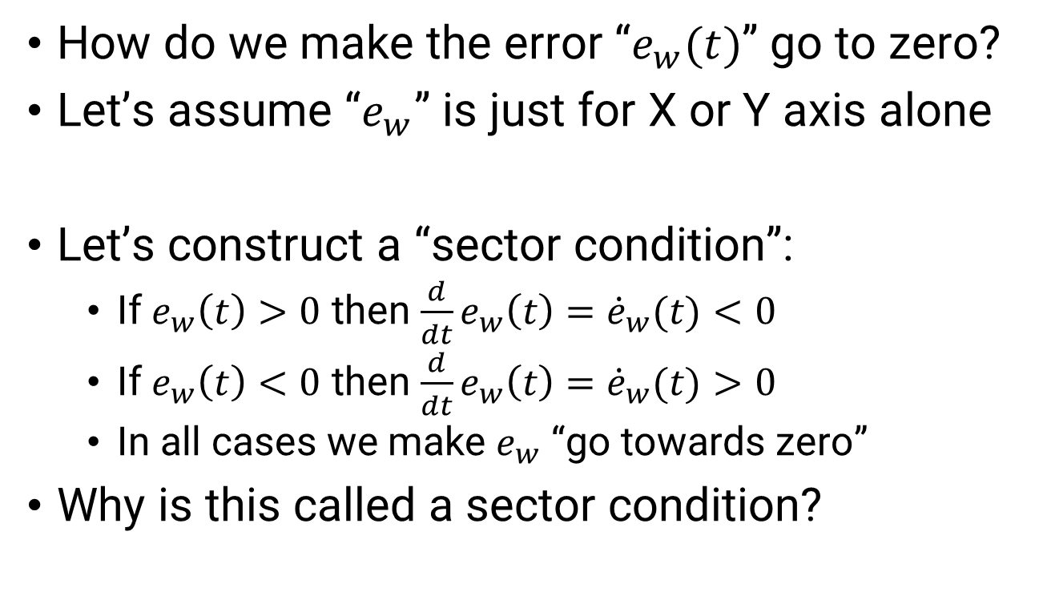
Trajectory Tracking Math
How do we make the error “$e_{w}(t)$” go to zero?
Let’s assume “$e_{w}$” is just for X or Y axis alone
Let’s construct a “sector condition”:
If $e_{w}\left(t\right)>0$ then $\frac{d}{dt}e_{w}\left(t\right)={\dot{e}}_{w}(t)<0$
If $e_{w}\left(t\right)<0$ then $\frac{d}{dt}e_{w}\left(t\right)={\dot{e}}_{w}(t)>0$
In all cases we make $e_{w}$ “go towards zero”
Why is this called a sector condition?
0
$$e$$

Slide 11

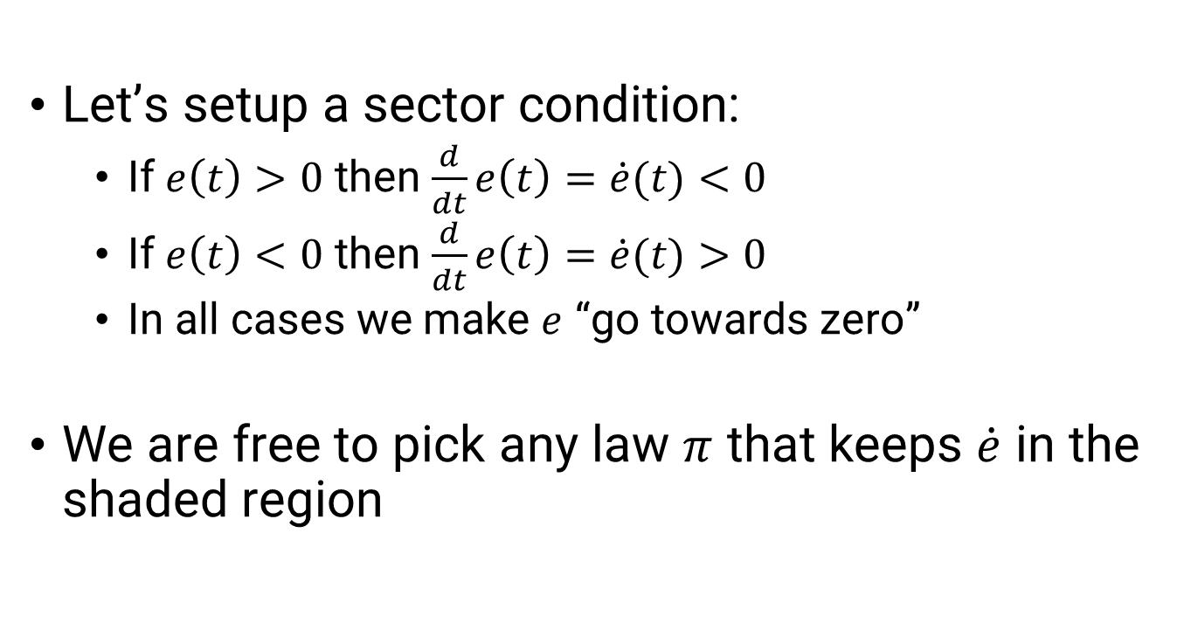

Trajectory Tracking Math
Let’s setup a sector condition:
If $e\left(t\right)>0$ then $\frac{d}{dt}e\left(t\right)=\dot{e}(t)<0$
If $e\left(t\right)<0$ then $\frac{d}{dt}e\left(t\right)=\dot{e}(t)>0$
In all cases we make $e$ “go towards zero”
We are free to pick any law $π$ that keeps $\dot{e}$ in the shaded region
$$\dot{e}$$
$$e$$

Slide 12
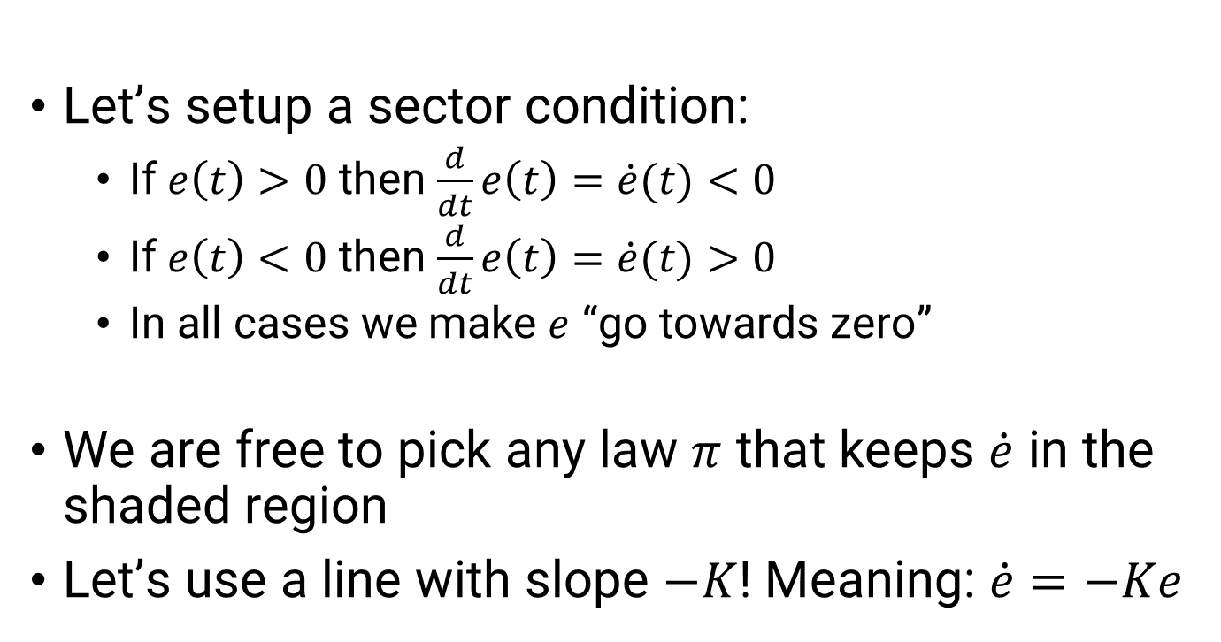

Trajectory Tracking Math
Let’s setup a sector condition:
If $e\left(t\right)>0$ then $\frac{d}{dt}e\left(t\right)=\dot{e}(t)<0$
If $e\left(t\right)<0$ then $\frac{d}{dt}e\left(t\right)=\dot{e}(t)>0$
In all cases we make $e$ “go towards zero”
We are free to pick any law $π$ that keeps $\dot{e}$ in the shaded region
Let’s use a line with slope $−K$! Meaning: $\dot{e}=−Ke$
$$\dot{e}$$
1
$$−K$$
$$e$$

Slide 13
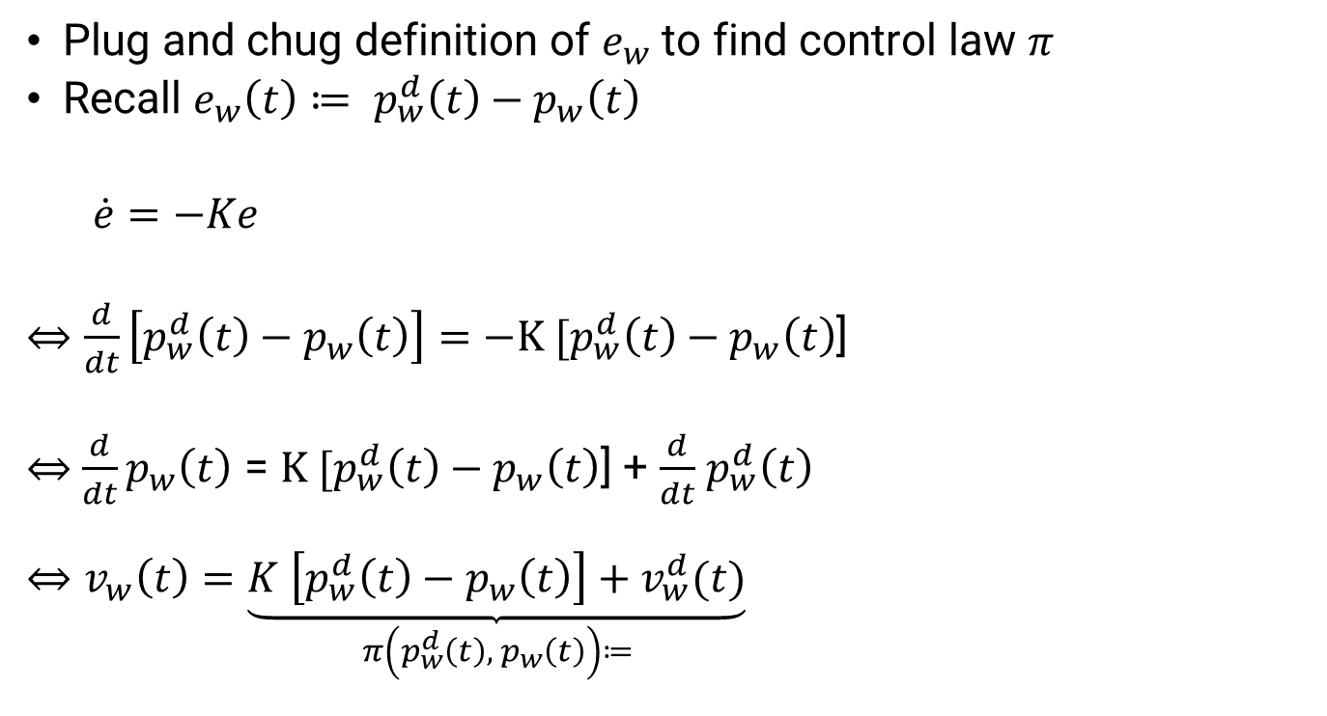
Trajectory Tracking Math
Plug and chug definition of $e_{w}$ to find control law $π$
Recall $e_{w}\left(t\right)≔ p_{w}^{d}\left(t\right)−p_{w}\left(t\right)$
$\dot{e}=−Ke$
$⇔\frac{d}{dt}\left[p_{w}^{d}\left(t\right)−p_{w}\left(t\right)\right]=−K [p_{w}^{d}\left(t\right)−p_{w}\left(t\right)$]
$⇔$ $\frac{d}{dt}p_{w}\left(t\right)$ = $K [p_{w}^{d}\left(t\right)−p_{w}\left(t\right)$] + $\frac{d}{dt}$ $p_{w}^{d}\left(t\right)$
$$⇔v_{w}\left(t\right)=\underset{π\left(p_{w}^{d}\left(t\right),{ p}_{w}\left(t\right)\right)≔}{\underbrace{K \left[p_{w}^{d}\left(t\right)−p_{w}\left(t\right)\right]+v_{w}^{d}(t)}}$$
$$\dot{e}$$
1
$$−K$$
$$e$$

Slide 14
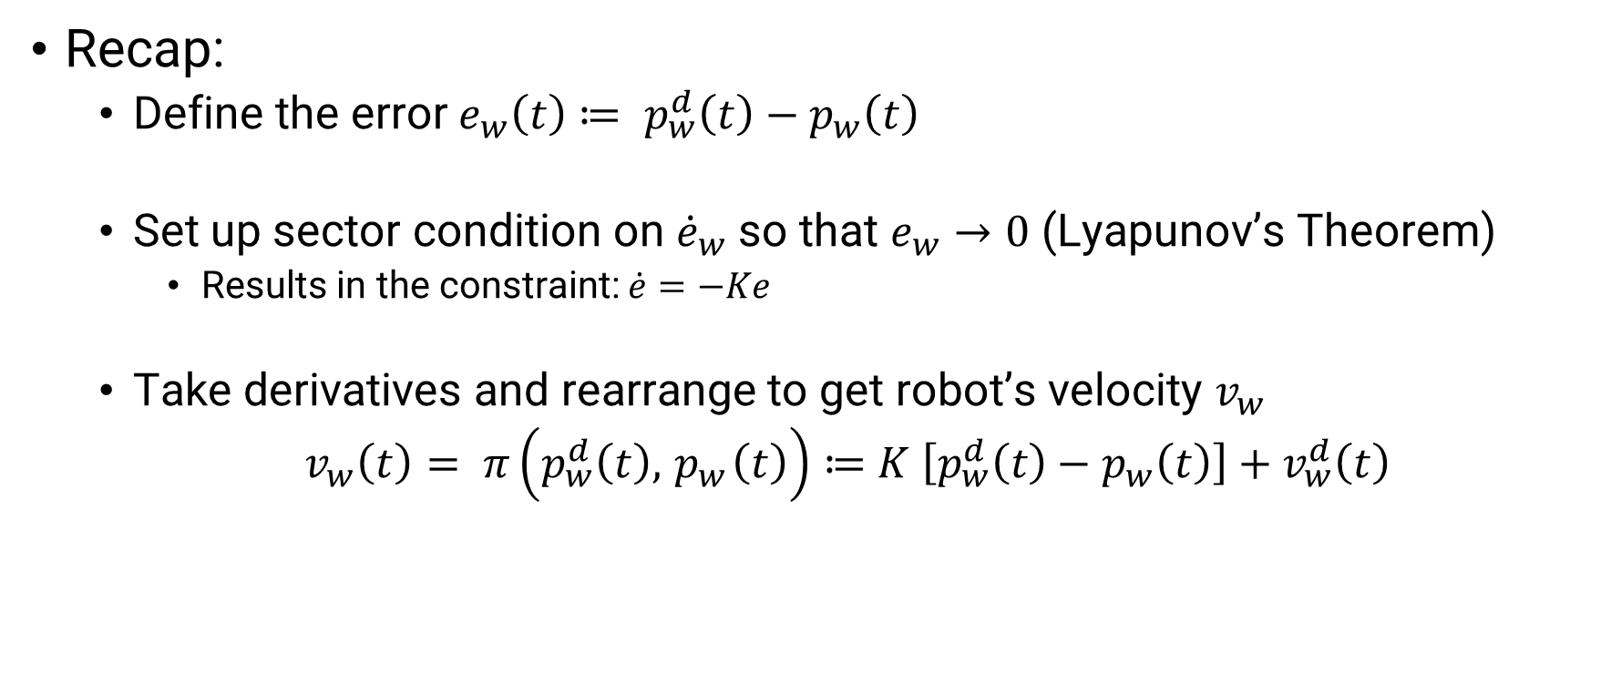
Trajectory Tracking Intuition
Recap:
Define the error $e_{w}\left(t\right)≔ p_{w}^{d}\left(t\right)−p_{w}\left(t\right)$
Set up sector condition on ${\dot{e}}_{w}$ so that $e_{w}→0$ (Lyapunov’s Theorem)
Results in the constraint: $\dot{e}=−Ke$
Take derivatives and rearrange to get robot’s velocity $v_{w}$
$v_{w}\left(t\right)= π\left(p_{w}^{d}\left(t\right),{ p}_{w}\left(t\right)\right)≔$ $K \left[p_{w}^{d}\left(t\right)−p_{w}\left(t\right)\right]+v_{w}^{d}\left(t\right)$

Slide 15

Trajectory Tracking Intuition
The terms in this controller have names
$$v_{w}\left(t\right)= π\left(p_{w}^{d}\left(t\right),{ p}_{w}\left(t\right)\right)≔\underset{Feedback}{\underbrace{K \left[p_{w}^{d}\left(t\right)−p_{w}\left(t\right)\right]}}+v_{w}^{d}\left(t\right)$$

Slide 16
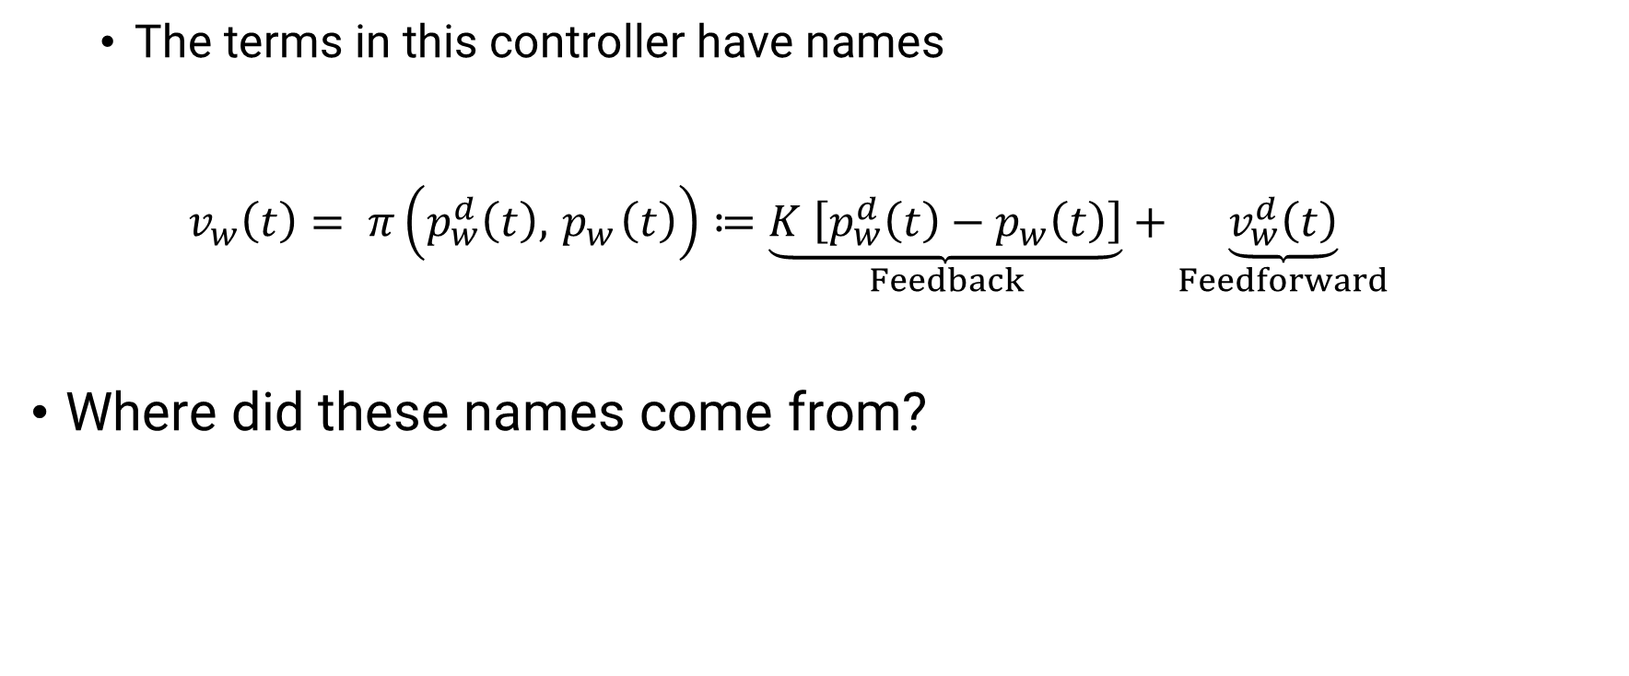
Trajectory Tracking Intuition
The terms in this controller have names
$$v_{w}\left(t\right)= π\left(p_{w}^{d}\left(t\right),{ p}_{w}\left(t\right)\right)≔\underset{Feedback}{\underbrace{K \left[p_{w}^{d}\left(t\right)−p_{w}\left(t\right)\right]}}+\underset{Feedforward}{\underbrace{v_{w}^{d}\left(t\right)}}$$
Where did these names come from?

Slide 17





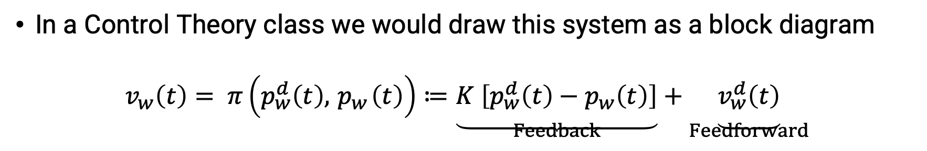






Trajectory Tracking Intuition
In a Control Theory class we would draw this system as a block diagram
$$v_{w}\left(t\right)= π\left(p_{w}^{d}\left(t\right),{ p}_{w}\left(t\right)\right)≔\underset{Feedback}{\underbrace{K \left[p_{w}^{d}\left(t\right)−p_{w}\left(t\right)\right]}}+\underset{Feedforward}{\underbrace{v_{w}^{d}\left(t\right)}}$$
$$\frac{d}{dt}$$
$$v_{w}^{d}$$
$$+$$
$$+$$
$$e_{w}$$
$$+$$
$$v_{w}$$
$$p_{w}$$
$$p_{w}^{d}$$
$$K$$
Robot
$$−$$

Slide 18
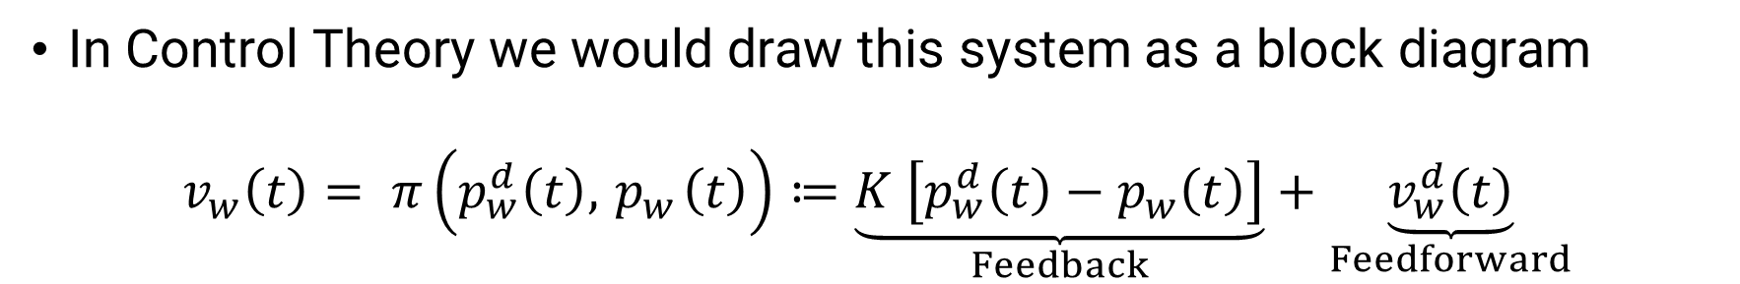
Trajectory Tracking Intuition
In Control Theory we would draw this system as a block diagram
$$v_{w}\left(t\right)= π\left(p_{w}^{d}\left(t\right),{ p}_{w}\left(t\right)\right)≔\underset{Feedback}{\underbrace{K \left[p_{w}^{d}\left(t\right)−p_{w}\left(t\right)\right]}}+\underset{Feedforward}{\underbrace{v_{w}^{d}\left(t\right)}}$$
$$\frac{d}{dt}$$
$$v_{w}^{d}$$
$$+$$
$$+$$
$$e_{w}$$
$$+$$
$$v_{w}$$
$$p_{w}$$
$$p_{w}^{d}$$
$$K$$
Robot
$$−$$
Feedback

Slide 19
Trajectory Tracking Intuition
In Control Theory we would draw this system as a block diagram
$$v_{w}\left(t\right)= π\left(p_{w}^{d}\left(t\right),{ p}_{w}\left(t\right)\right)≔\underset{Feedback}{\underbrace{K \left[p_{w}^{d}\left(t\right)−p_{w}\left(t\right)\right]}}+\underset{Feedforward}{\underbrace{v_{w}^{d}\left(t\right)}}$$
Feedforward
$$\frac{d}{dt}$$
$$v_{w}^{d}$$
$$+$$
$$+$$
$$e_{w}$$
$$+$$
$$v_{w}$$
$$p_{w}$$
$$p_{w}^{d}$$
$$K$$
Robot
$$−$$
Feedback

Slide 20
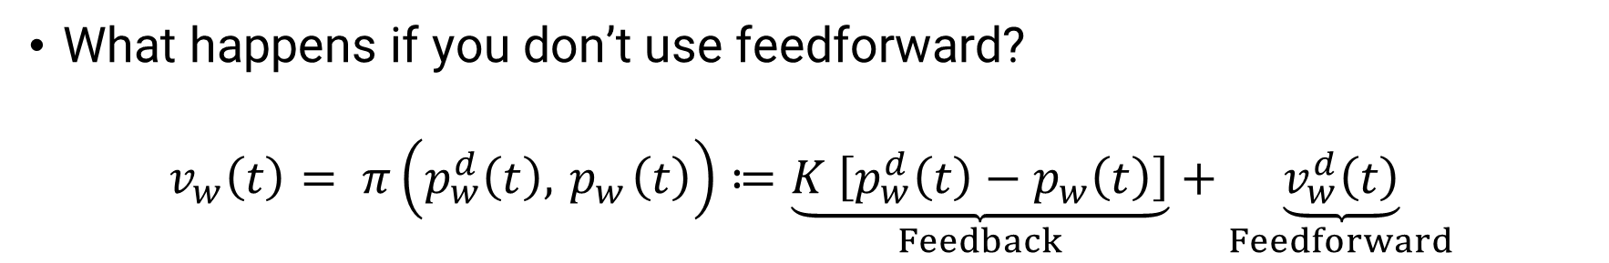
Trajectory Tracking Intuition
What happens if you don’t use feedforward?
$$v_{w}\left(t\right)= π\left(p_{w}^{d}\left(t\right),{ p}_{w}\left(t\right)\right)≔\underset{Feedback}{\underbrace{K \left[p_{w}^{d}\left(t\right)−p_{w}\left(t\right)\right]}}+\underset{Feedforward}{\underbrace{v_{w}^{d}\left(t\right)}}$$
Feedforward
$$\frac{d}{dt}$$
$$v_{w}^{d}$$
$$+$$
$$+$$
$$e_{w}$$
$$+$$
$$v_{w}$$
$$p_{w}$$
$$p_{w}^{d}$$
$$K$$
Robot
$$−$$
Feedback

Slide 21
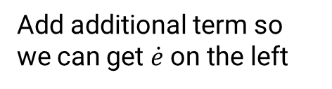
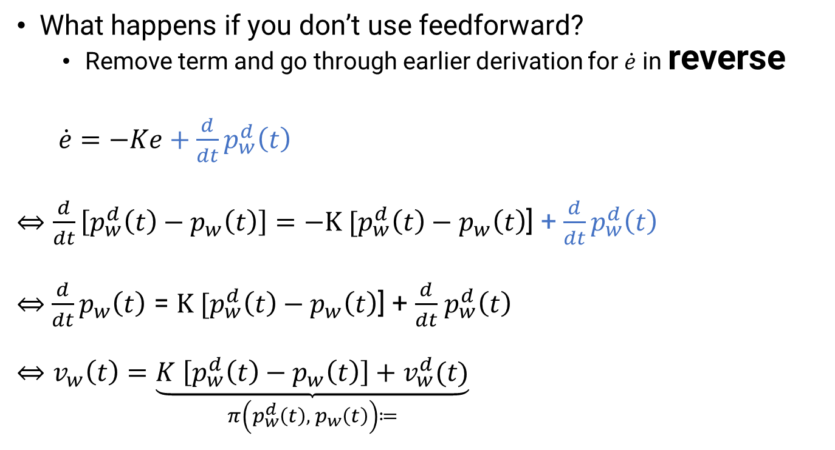
Trajectory Tracking Intuition
What happens if you don’t use feedforward?
Remove term and go through earlier derivation for $\dot{e}$ in reverse
$\dot{e}=−Ke+\frac{d}{dt}p_{w}^{d}\left(t\right)$
$⇔\frac{d}{dt}\left[p_{w}^{d}\left(t\right)−p_{w}\left(t\right)\right]=−K [p_{w}^{d}\left(t\right)−p_{w}\left(t\right)$] + $\frac{d}{dt}p_{w}^{d}\left(t\right)$
$⇔$ $\frac{d}{dt}p_{w}\left(t\right)$ = $K [p_{w}^{d}\left(t\right)−p_{w}\left(t\right)$] + $\frac{d}{dt}$ $p_{w}^{d}\left(t\right)$
$$⇔v_{w}\left(t\right)=\underset{π\left(p_{w}^{d}\left(t\right),{ p}_{w}\left(t\right)\right)≔}{\underbrace{K \left[p_{w}^{d}\left(t\right)−p_{w}\left(t\right)\right]+v_{w}^{d}(t)}}$$
Add additional term so we can get $\dot{e}$ on the left

Slide 22
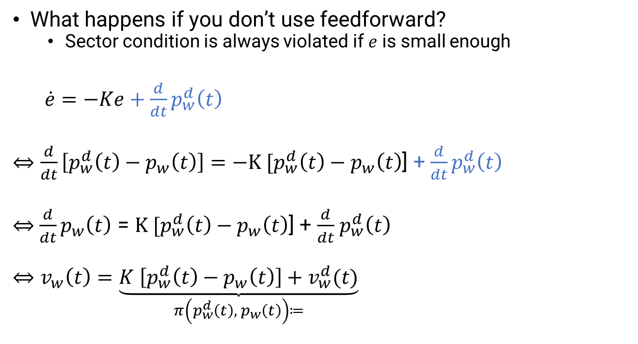

Trajectory Tracking Intuition
$$\frac{d}{dt}p_{w}^{d}$$
What happens if you don’t use feedforward?
Sector condition is always violated if $e$ is small enough
$\dot{e}=−Ke+\frac{d}{dt}p_{w}^{d}\left(t\right)$
$⇔\frac{d}{dt}\left[p_{w}^{d}\left(t\right)−p_{w}\left(t\right)\right]=−K [p_{w}^{d}\left(t\right)−p_{w}\left(t\right)$] + $\frac{d}{dt}p_{w}^{d}\left(t\right)$
$⇔$ $\frac{d}{dt}p_{w}\left(t\right)$ = $K [p_{w}^{d}\left(t\right)−p_{w}\left(t\right)$] + $\frac{d}{dt}$ $p_{w}^{d}\left(t\right)$
$$⇔v_{w}\left(t\right)=\underset{π\left(p_{w}^{d}\left(t\right),{ p}_{w}\left(t\right)\right)≔}{\underbrace{K \left[p_{w}^{d}\left(t\right)−p_{w}\left(t\right)\right]+v_{w}^{d}(t)}}$$
$$\dot{e}$$
$$e$$

Slide 23
Trajectory Tracking Intuition
$$\frac{d}{dt}p_{w}^{d}$$
What happens if you don’t use feedforward?
The error always grows if
error is small
desired velocity is high enough
$$\dot{e}$$
$$e$$

Slide 24
Trajectory Tracking Intuition
$$\frac{d}{dt}p_{w}^{d}$$
What happens if you don’t use feedforward?
The error always grows if
error is small
desired velocity is high enough
Without feedforward
The trajectory will never be tracked perfectly!
The trajectory will always be tracked approximately!
What does approximately mean?
$$\dot{e}$$
$$e$$

Slide 25
Trajectory Tracking Intuition
$$\frac{d}{dt}p_{w}^{d}$$
What happens if you don’t use feedforward?
The error always grows if
error is small
desired velocity is high enough
Without feedforward
The trajectory will never be tracked perfectly!
The trajectory will always be tracked with bounded error!
What does the bound depend on?
$$\dot{e}$$
$$e$$

Slide 26
Trajectory Tracking Intuition
$$\frac{d}{dt}p_{w}^{d}$$
What happens if you don’t use feedforward?
The error always grows if
error is small
desired velocity is high enough
Without feedforward
The trajectory will never be tracked perfectly!
The trajectory will always be tracked with bounded error!
What does the bound depend on?
Top desired speed and the slope (K)
$$\dot{e}$$
$$e$$

Slide 27
Trajectory Tracking Without Feedforward
Green dot is desired
Blue dot is achieved

Slide 28
Trajectory Tracking with Feedforward
Green dot is desired
Blue dot is achieved

Slide 29
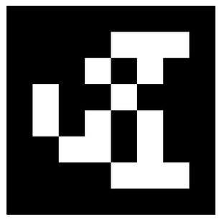
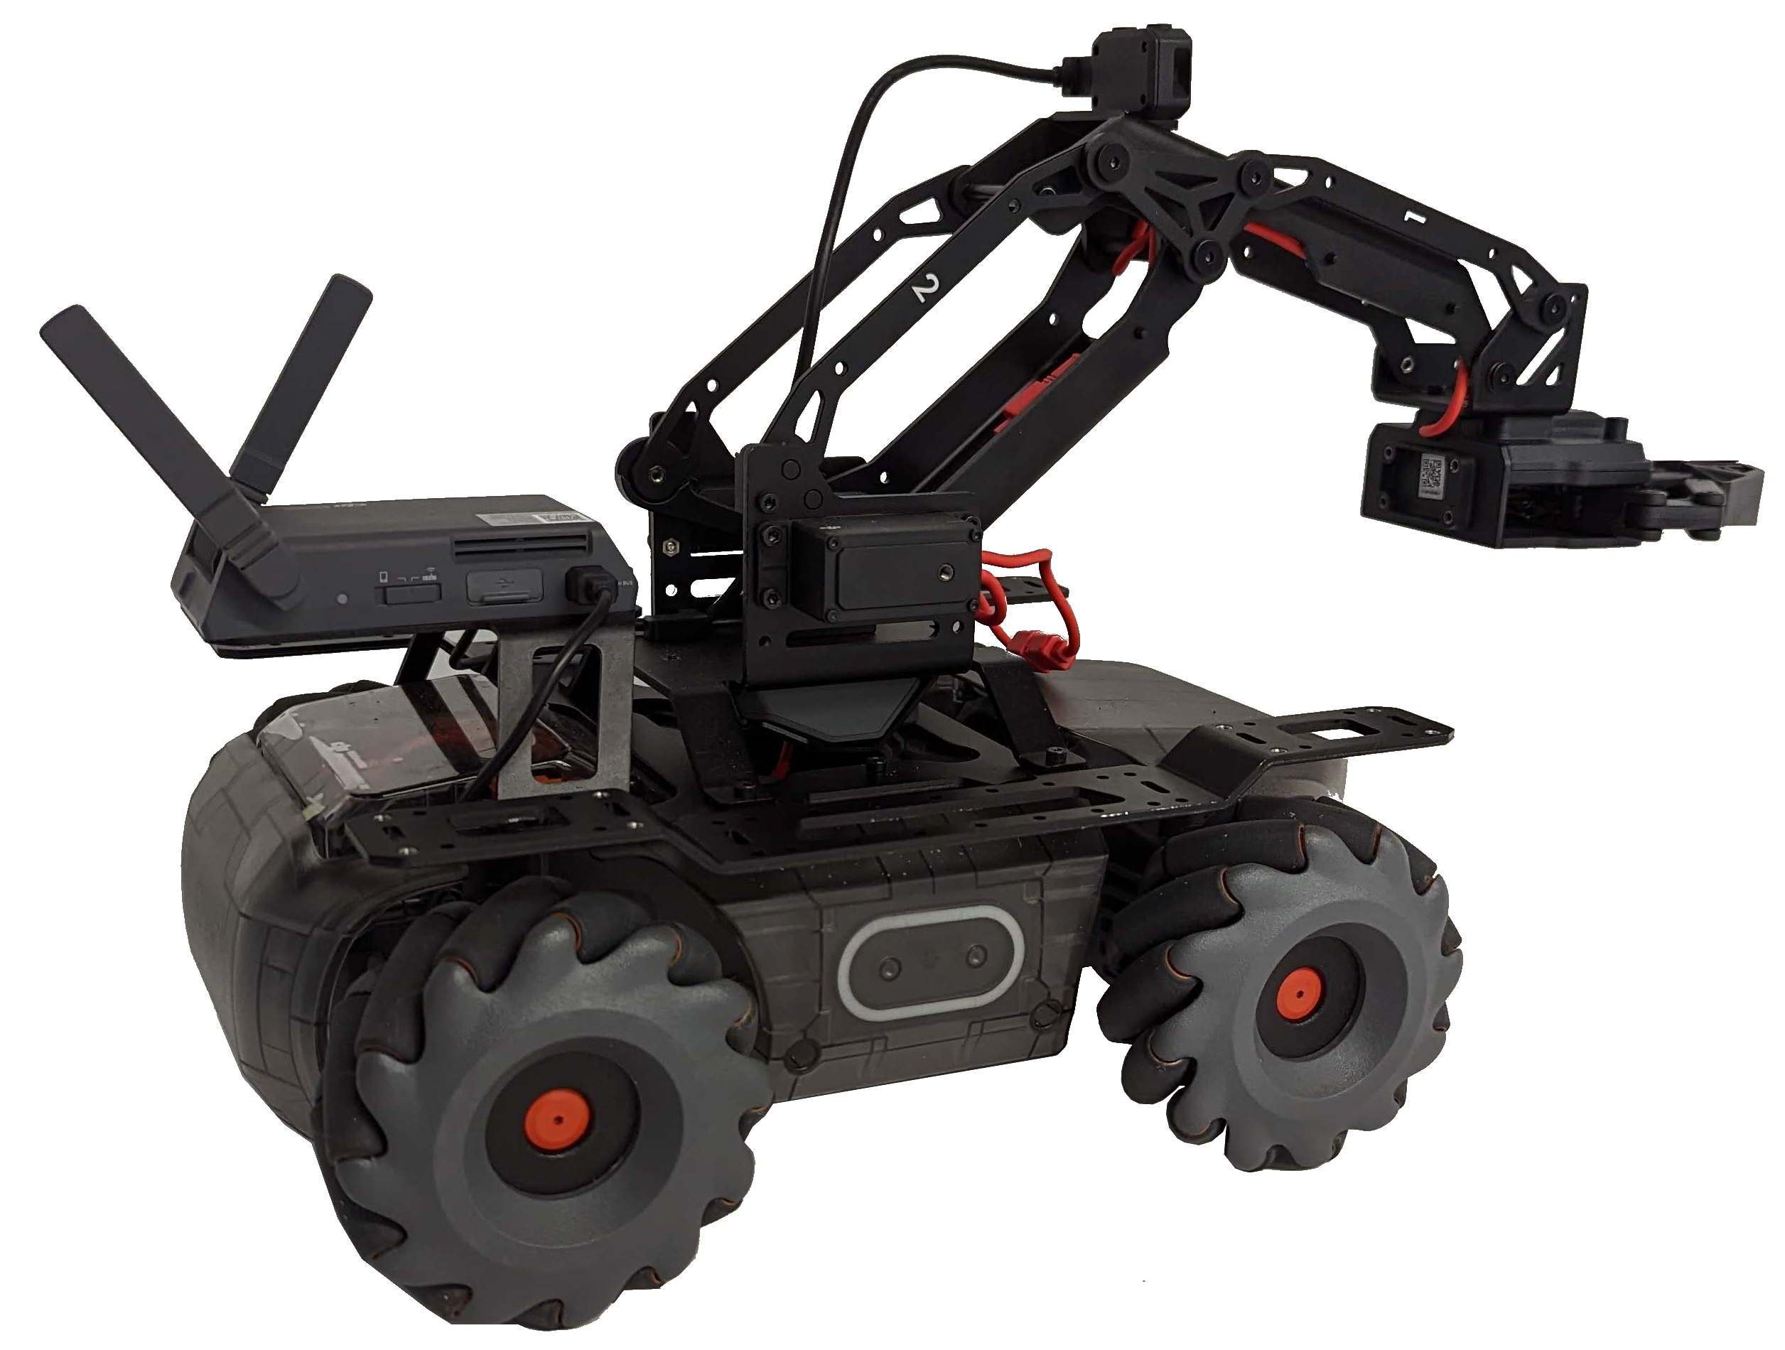
3D Transforms
This control stuff was great but
We need to determine position in world
Using measurements in camera frame
We need to set velocity in world
By setting our velocity in robot frame
How to measure our position and orientation using camera + AprilTags?

Slide 30
3D Transforms
First we need to learn about transforms
Suppose we have a world frame
z
y
World
x

Slide 31
3D Transforms
First we need to learn about transforms
Suppose we have a world frame
Suppose there is another frame in the world frame (AprilTag)
z
y
z
April
World
x
y
x

Slide 32
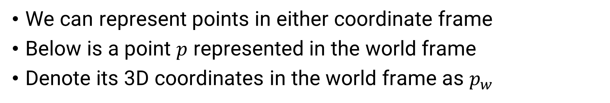


3D Transforms
We can represent points in either coordinate frame
Below is a point $p$ represented in the world frame
Denote its 3D coordinates in the world frame as $p_{w}$
z
y
z
April
$$p$$
World
x
y
x
$$p_{w}$$

Slide 33
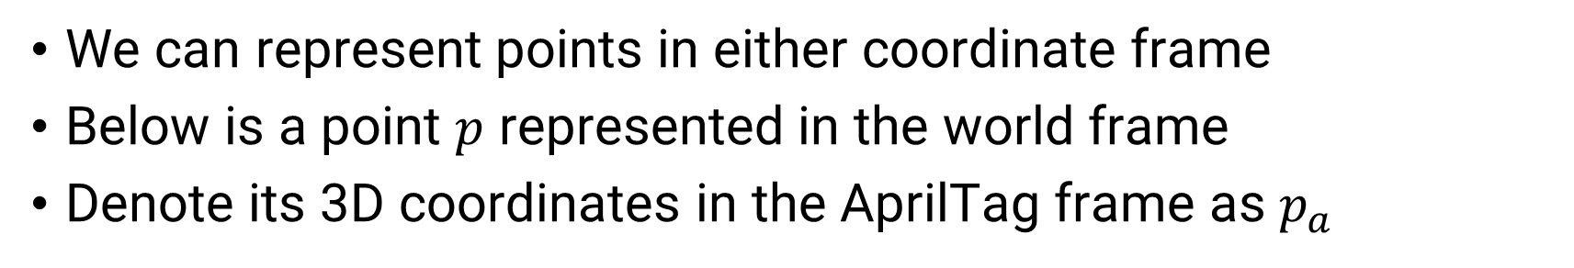

3D Transforms
We can represent points in either coordinate frame
Below is a point $p$ represented in the world frame
Denote its 3D coordinates in the AprilTag frame as $p_{a}$
z
y
z
April
$$p_{a}$$
y
x
$$p$$
World
x

Slide 34
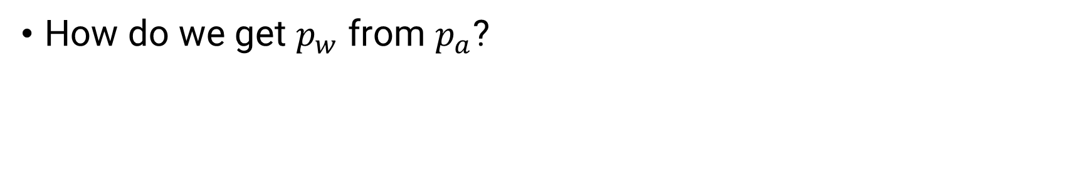



3D Transforms
z
How do we get $p_{w}$ from $p_{a}$?
y
z
April
$$p_{a}$$
y
x
$$p$$
World
x
$$p_{w}$$

Slide 35


3D Transforms
z
How do we get $p_{w}$ from $p_{a}$?
We need two pieces of info
Translation between frames
Denoted by${ t}_{wa}$
y
z
April
$$t_{wa}$$
$$p$$
World
x
y
x

Slide 36


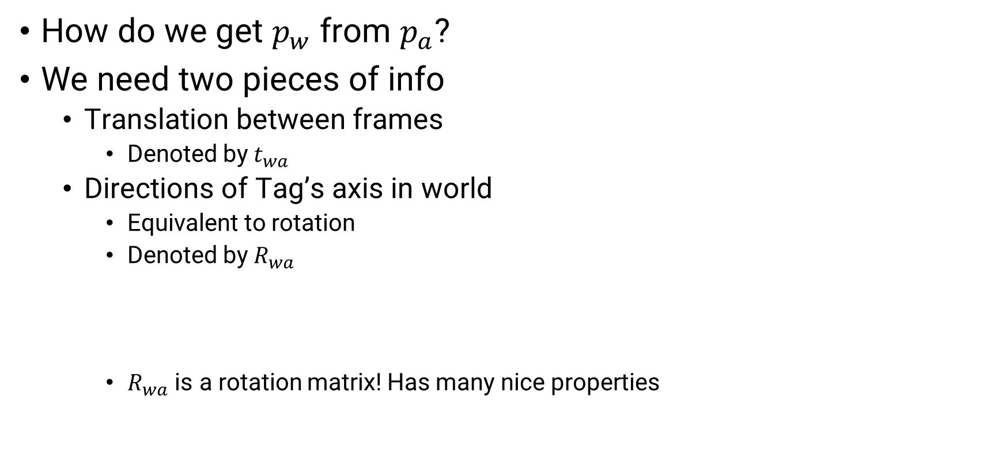


3D Transforms
z
How do we get $p_{w}$ from $p_{a}$?
We need two pieces of info
Translation between frames
Denoted by${ t}_{wa}$
Directions of Tag’s axis in world
Equivalent to rotation
Denoted by $R_{wa}$
$R_{wa}$ is a rotation matrix! Has many nice properties
y
$$p_{w}^{a_{z}}$$
April
$$p_{w}^{a_{x}}$$
$$t_{wa}$$
$$p$$
World
$$p_{w}^{a_{y}}$$
x
$$R_{wa}≔\left[\begin{matrix} & & \\ p_{w}^{a_{x}} −{ t}_{wa} & p_{w}^{a_{y}} −{ t}_{wa} & p_{w}^{a_{z}} −{ t}_{wa} \\ & & \end{matrix}\right]$$

Slide 37

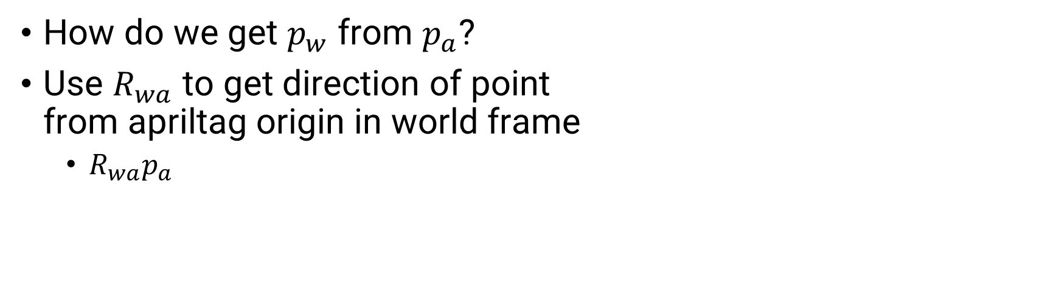
3D Transforms
z
How do we get $p_{w}$ from $p_{a}$?
Use $R_{wa}$ to get direction of point from apriltag origin in world frame
$R_{wa}p_{a}$
y
$$p_{w}^{a_{z}}$$
April
$$p_{w}^{a_{x}}$$
$$p$$
World
$$R_{wa}p_{a}$$
$$p_{w}^{a_{y}}$$
x

Slide 38

3D Transforms
z
How do we get $p_{w}$ from $p_{a}$?
Use $R_{wa}$ to get direction of point from apriltag origin in world frame
$R_{wa}p_{a}$
Add the origin shift
${R_{wa}p_{a}+ t}_{wa}$
And you’re done
$p_{w}=R_{wa}p_{a}+t_{wa}$
y
$$p_{w}^{a_{z}}$$
April
$$p_{w}^{a_{x}}$$
$$t_{wa}$$
$$p$$
World
$$R_{wa}p_{a}$$
$$p_{w}^{a_{y}}$$
x
$$p_{w}$$

Slide 39
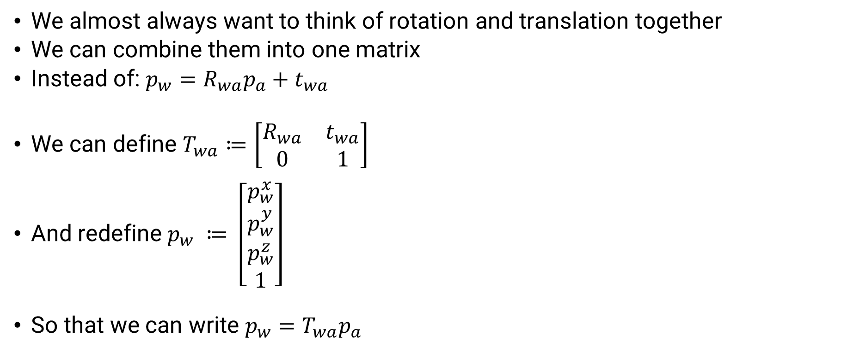
3D Transforms
We almost always want to think of rotation and translation together
We can combine them into one matrix
Instead of: $p_{w}=R_{wa}p_{a}+t_{wa}$
We can define $T_{wa}≔\left[\begin{matrix}R_{wa} & t_{wa} \\ 0 & 1\end{matrix}\right]$
And redefine $p_{w} ≔ \left[\begin{matrix}p_{w}^{x} \\ p_{w}^{y} \\ p_{w}^{z} \\ 1\end{matrix}\right]$
So that we can write $p_{w}=T_{wa}p_{a}$

Slide 40

3D Transforms
Choice in subscript order allows figuring out the cancelation
$p_{w}=T_{wa}p_{a}$

Slide 41
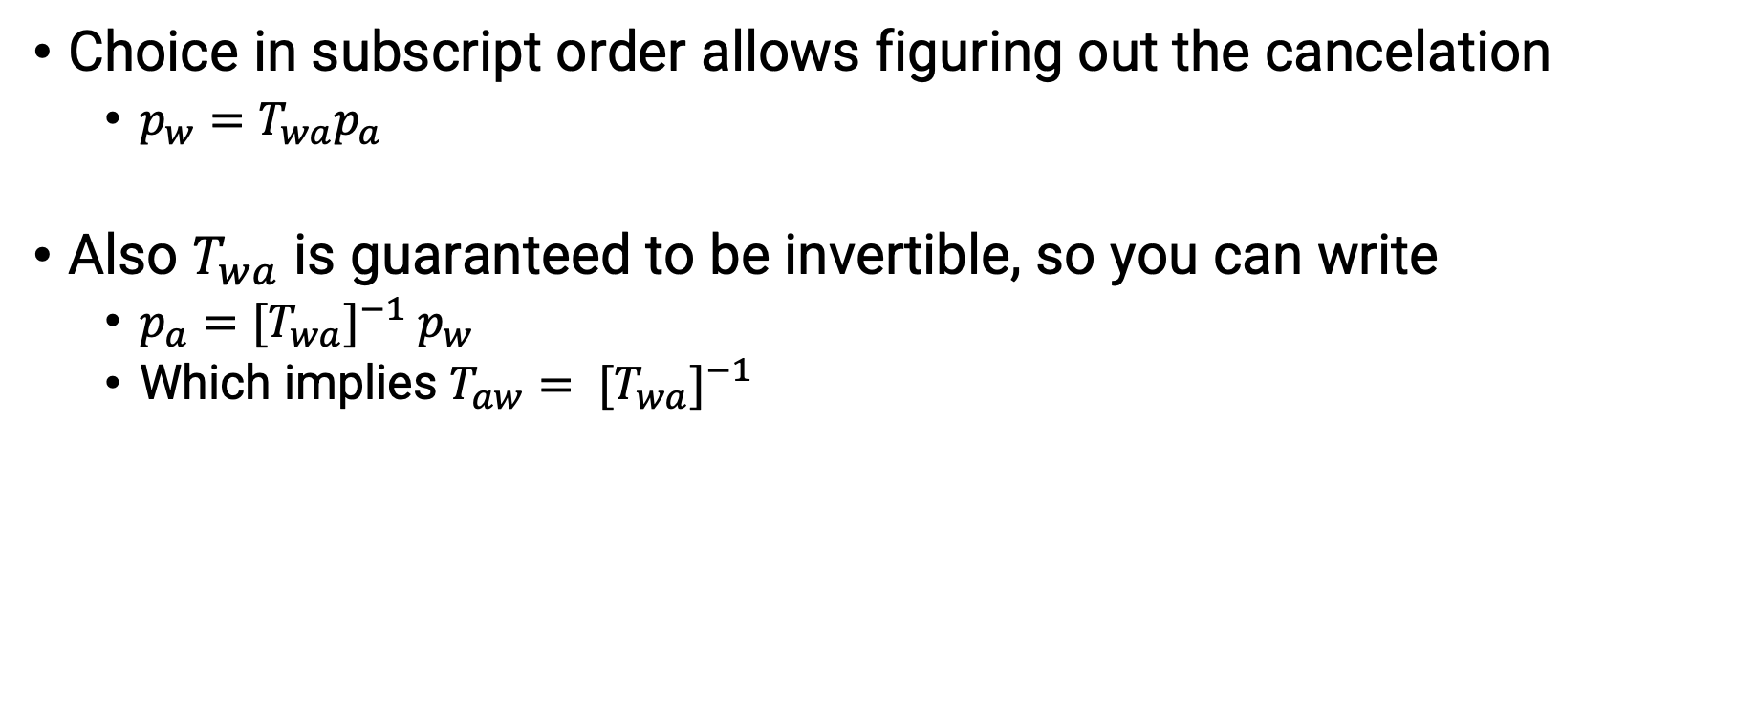
3D Transforms
Choice in subscript order allows figuring out the cancelation
$p_{w}=T_{wa}p_{a}$
Also $T_{wa}$ is guaranteed to be invertible, so you can write
$p_{a}={[T}_{wa}]^{−1} p_{w}$
Which implies $T_{aw}= {[T}_{wa}]^{−1}$

Slide 42
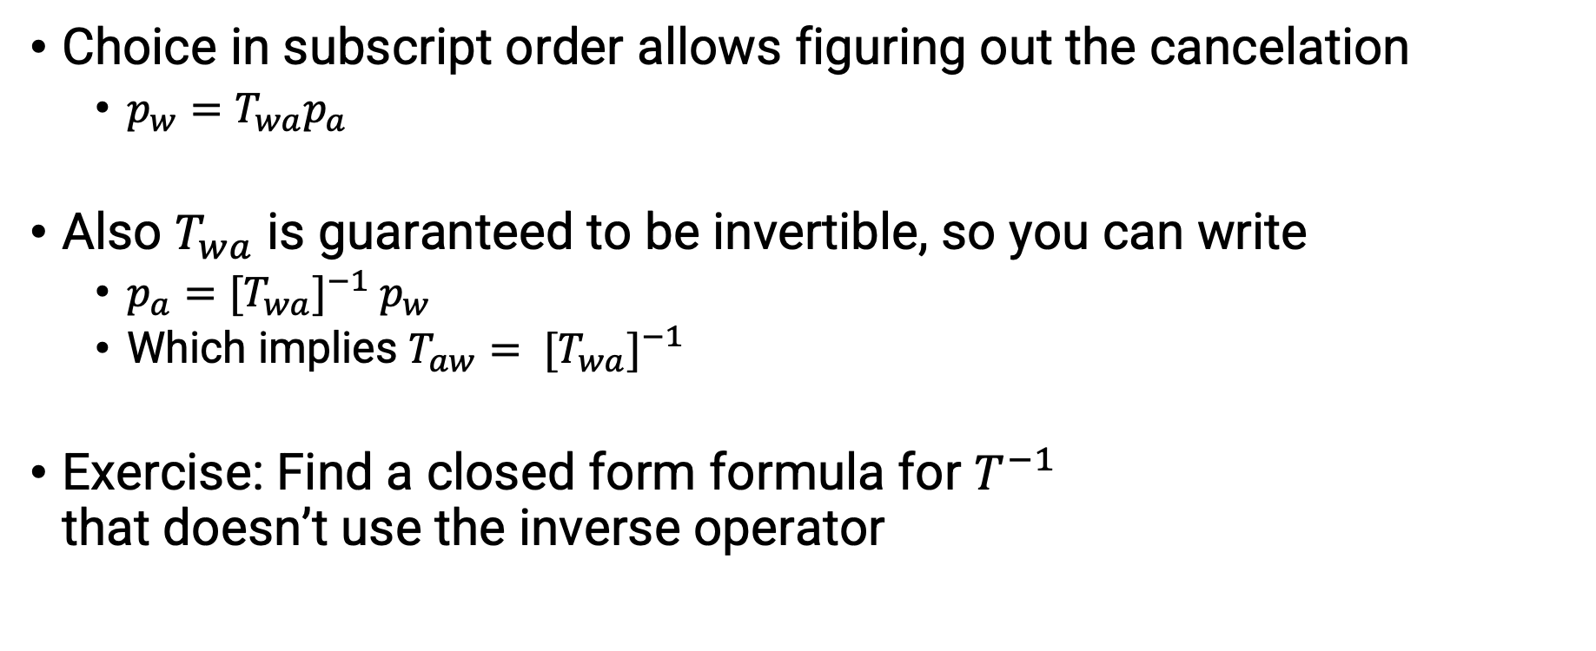
3D Transforms
Choice in subscript order allows figuring out the cancelation
$p_{w}=T_{wa}p_{a}$
Also $T_{wa}$ is guaranteed to be invertible, so you can write
$p_{a}={[T}_{wa}]^{−1} p_{w}$
Which implies $T_{aw}= {[T}_{wa}]^{−1}$
Exercise: Find a closed form formula for $T^{−1}$ that doesn’t use the inverse operator

Slide 43
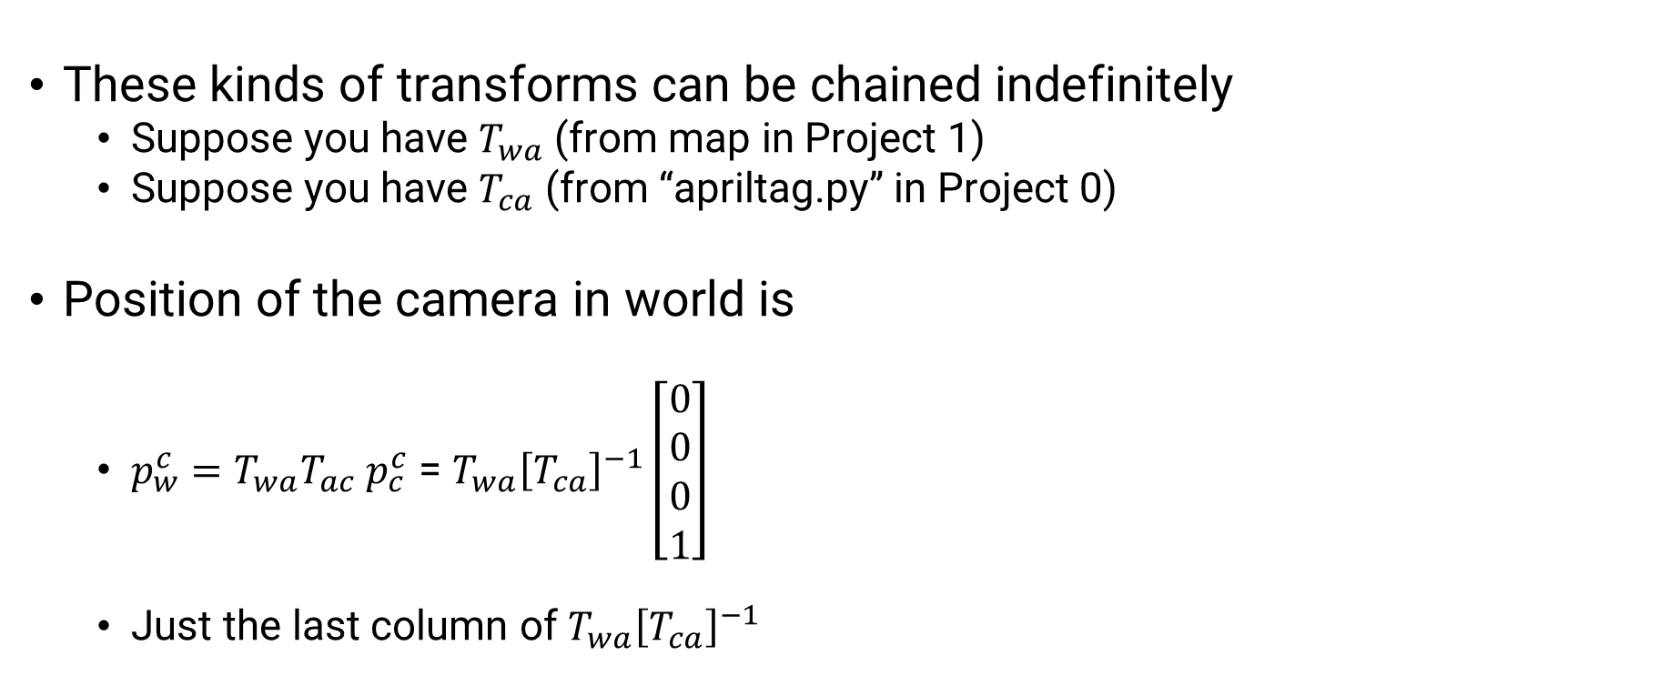
3D Transforms
These kinds of transforms can be chained indefinitely
Suppose you have $T_{wa}$ (from map in Project 1)
Suppose you have $T_{ca}$ (from “apriltag.py” in Project 0)
Position of the camera in world is
$p_{w}^{c}=T_{wa}T_{ac}$ $p_{c}^{c}$ = $T_{wa}{\left[T_{ca}\right]}^{−1}\left[\begin{matrix}0 \\ 0 \\ 0 \\ 1\end{matrix}\right]$
Just the last column of $T_{wa}{\left[T_{ca}\right]}^{−1}$

Slide 44

3D Transforms
These kinds of transforms can be chained indefinitely
Suppose you have $T_{wa}$ (from map in Project 1)
Suppose you have $T_{ca}$ (from “apriltag.py” in Project 0)
Position of the camera in world is
$p_{w}^{c}=T_{wa}T_{ac}$ $p_{c}^{c}$ = $T_{wa}{\left[T_{ca}\right]}^{−1}\left[\begin{matrix}0 \\ 0 \\ 0 \\ 1\end{matrix}\right]$
Just the last column of $T_{wa}{\left[T_{ca}\right]}^{−1}$
Orientation is
$R_{wc}=R_{wa}R_{ac}=R_{wa}{[R}_{ca}]^{−1}$

Slide 45

3D Transforms
We can get position and orientation in the world
$p_{w}^{c}=T_{wa}T_{ac}$ $p_{c}^{c}$
$R_{wc}=R_{wa}R_{ac}$
And we can calculate our desired velocity in world frame through $π$
$v_{w}=π(p_{w}^{d}\left(t\right), p_{w}^{c}\left(t\right))$

Slide 46
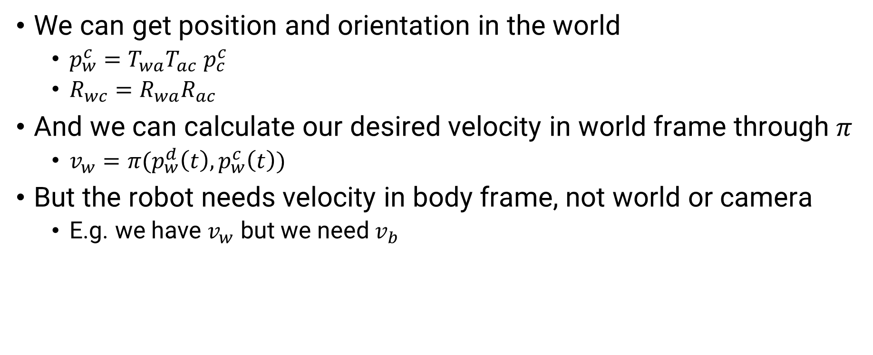
3D Transforms
We can get position and orientation in the world
$p_{w}^{c}=T_{wa}T_{ac}$ $p_{c}^{c}$
$R_{wc}=R_{wa}R_{ac}$
And we can calculate our desired velocity in world frame through $π$
$v_{w}=π(p_{w}^{d}\left(t\right), p_{w}^{c}\left(t\right))$
But the robot needs velocity in body frame, not world or camera
E.g. we have $v_{w}$ but we need $v_{b}$

Slide 47
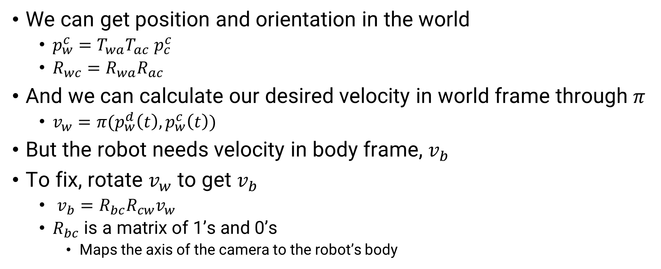
3D Transforms
We can get position and orientation in the world
$p_{w}^{c}=T_{wa}T_{ac}$ $p_{c}^{c}$
$R_{wc}=R_{wa}R_{ac}$
And we can calculate our desired velocity in world frame through $π$
$v_{w}=π(p_{w}^{d}\left(t\right), p_{w}^{c}\left(t\right))$
But the robot needs velocity in body frame, $v_{b}$
To fix, rotate $v_{w}$ to get $v_{b}$
$v_{b}=R_{bc}R_{cw}v_{w}$
$R_{bc}$ is a matrix of 1’s and 0’s
Maps the axis of the camera to the robot’s body

Slide 48

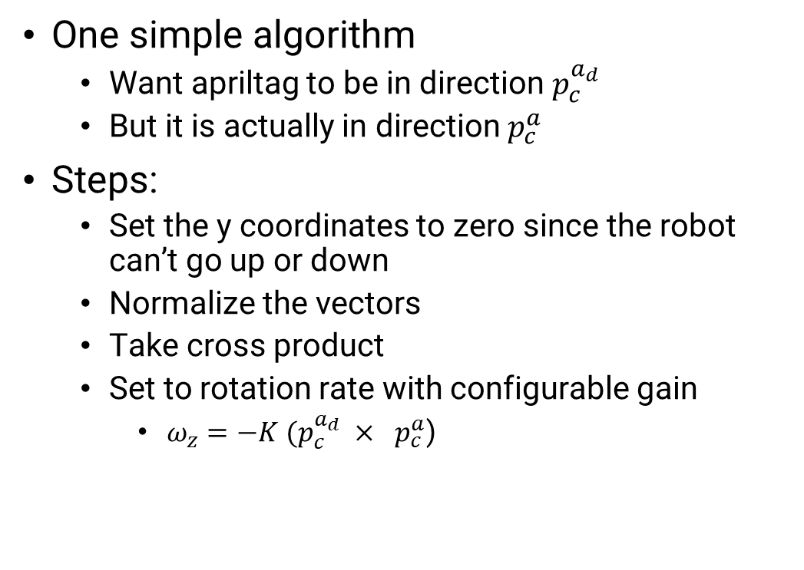
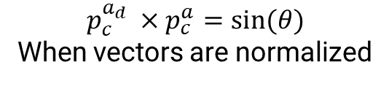
Heading Control
One simple algorithm
Want apriltag to be in direction $p_{c}^{a_{d}}$
But it is actually in direction $p_{c}^{a}$
Steps:
Set the y coordinates to zero since the robot can’t go up or down
Normalize the vectors
Take cross product
Set to rotation rate with configurable gain
$ω_{z}=−K (p_{c}^{a_{d}} × ⁡$ $p_{c}^{a}$)
$$p_{c}^{a}$$
$$θ$$
$$p_{c}^{a_{d}}$$
$$p_{c}^{a_{d}} ×p_{c}^{a}=sin(θ)$$
When vectors are normalized

Slide 49
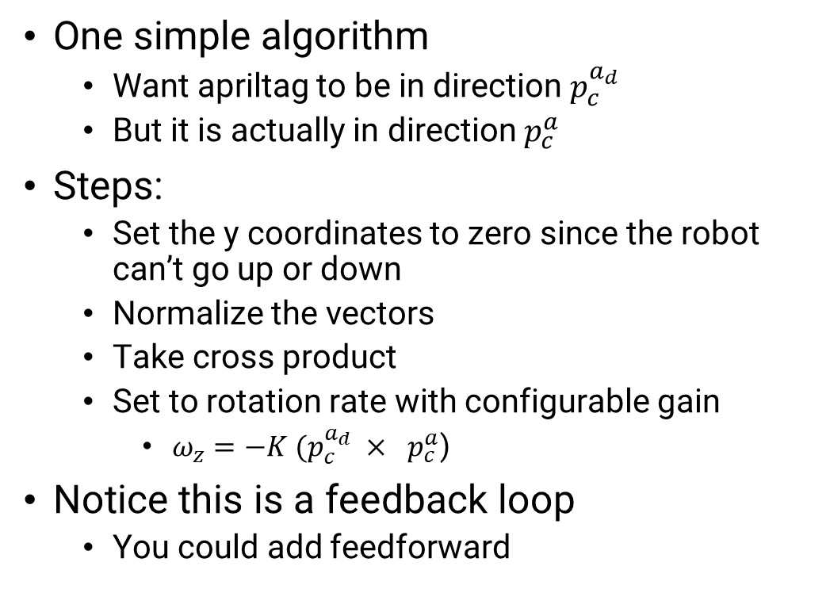
Heading Control
One simple algorithm
Want apriltag to be in direction $p_{c}^{a_{d}}$
But it is actually in direction $p_{c}^{a}$
Steps:
Set the y coordinates to zero since the robot can’t go up or down
Normalize the vectors
Take cross product
Set to rotation rate with configurable gain
$ω_{z}=−K (p_{c}^{a_{d}} × ⁡$ $p_{c}^{a}$)
Notice this is a feedback loop
You could add feedforward
$$p_{c}^{a}$$
$$θ$$
$$p_{c}^{a_{d}}$$
$$p_{c}^{a_{d}} ×p_{c}^{a}=sin(θ)$$
When vectors are normalized

Slide 50
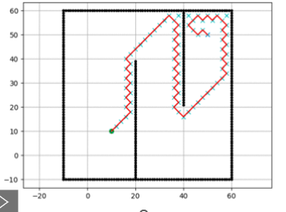
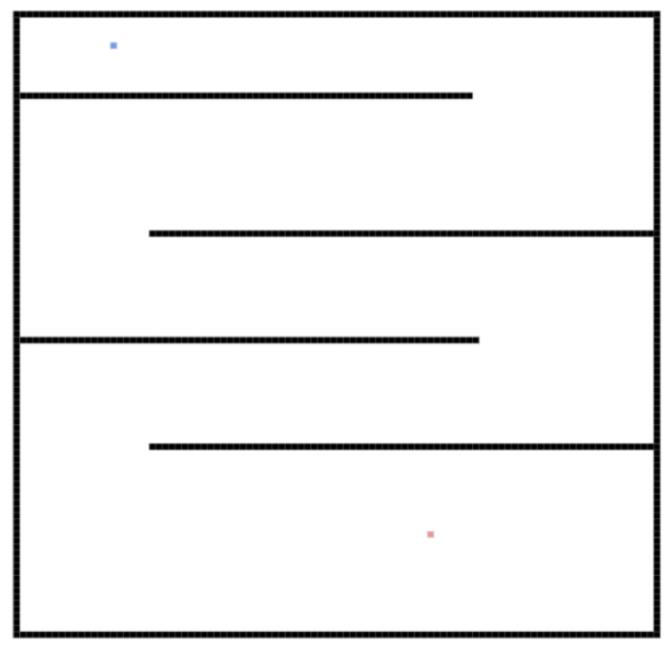
Interpolation
Search based planning returns set of points
But robot moves continuously
Control expects continuous target position
Indexed by a time “t”
What can we do?
We need to interpolate the points!
Notes:
https://github.com/zhm-real/PathPlanning

Slide 51
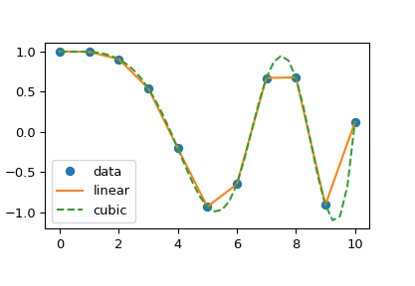
Interpolation
Scipy has a great library of interpolation functions
We encourage you to just use them
This tutorial covers the basics concisely
https://docs.scipy.org/doc/scipy/tutorial/interpolate/1D.html
Notes:
https://github.com/zhm-real/PathPlanning

Slide 52
Interpolation
What kind of interpolation was used in this visualization?
Notes:
https://github.com/zhm-real/PathPlanning

Slide 53
Interpolation
What kind of interpolation was used in this visualization?
It’s pretty jagged
You likely would want to at least use cubic interpolation
And adjust algorithm to search along horizontal and vertical directions
Notes:
https://github.com/zhm-real/PathPlanning

Slide 54
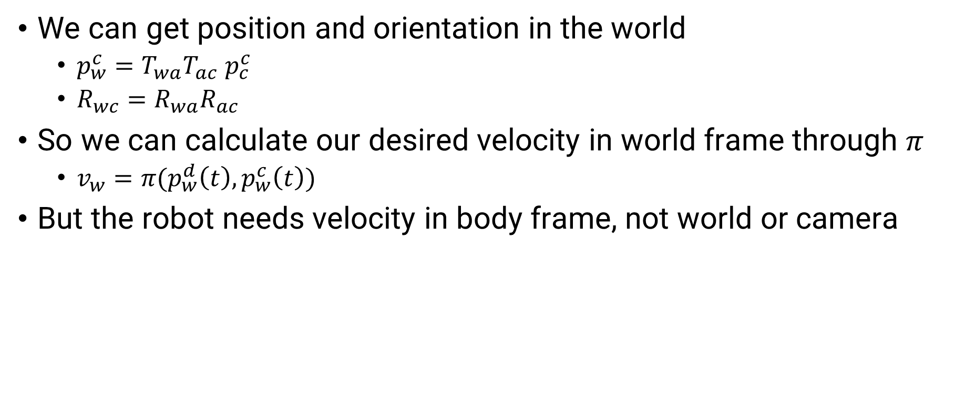
3D Transforms
We can get position and orientation in the world
$p_{w}^{c}=T_{wa}T_{ac}$ $p_{c}^{c}$
$R_{wc}=R_{wa}R_{ac}$
So we can calculate our desired velocity in world frame through $π$
$v_{w}=π(p_{w}^{d}\left(t\right), p_{w}^{c}\left(t\right))$
But the robot needs velocity in body frame, not world or camera

Slide 55

3D Transforms
We have $v_{w}$ but we need $v_{b}$, we have $p_{w}$ and $p_{b}$
So what do we do? We take derivatives!
Define velocity body in world as $v_{w}^{b}≔v_{w}$

Slide 56
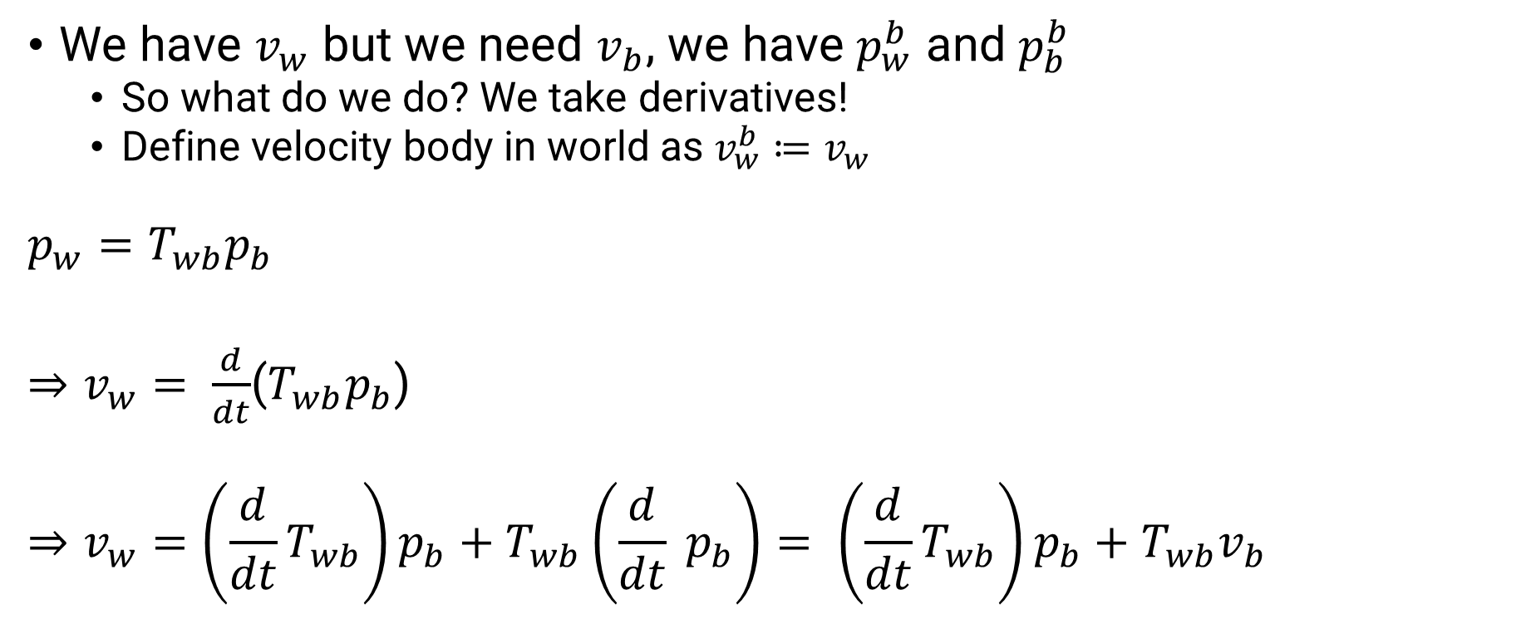
3D Transforms
We have $v_{w}$ but we need $v_{b}$, we have $p_{w}^{b}$ and $p_{b}^{b}$
So what do we do? We take derivatives!
Define velocity body in world as $v_{w}^{b}≔v_{w}$
$$p_{w}=T_{wb}p_{b}$$
$⇒v_{w}= \frac{d}{dt}$($T_{wb}p_{b}$)
$$⇒v_{w}=\left(\frac{d}{dt}T_{wb}\right)p_{b}+T_{wb}\left(\frac{d}{dt} p_{b}\right)= \left(\frac{d}{dt}T_{wb}\right)p_{b}+T_{wb}v_{b}$$

